Slide 1
Virginia Reinhardt Elementary Exploratory Options Renovation vs Rebuild

Slide 2
Bond Election Order
“SHALL the Board of Trustees of the Rockwall Independent School District in Rockwall, Kaufman and Collin Counties, Texas be authorized to issue bonds of the District in the principal amount of $256,820,000 for the construction, renovation, demolition, acquisition and equipment of school buildings in the District, the purchase of necessary sites for school buildings and the purchase of new school buses; and shall there be pledged and levied, assessed and collected annually ad valorem taxes on all taxable property in the District sufficient, without limit as to rate or amount, to pay the principal of and interest on said bonds and the costs of any credit agreements executed in connection with the bonds; said bonds to mature serially or otherwise not more than thirty (30) years from their date, to be issued in one or more series at any price or prices, and to bear interest at such rate or rates (fixed, floating, variable or otherwise and not to exceed the maximum rate permitted by law at the time of issuance of the bonds) as in its discretion the Board of Trustees shall determine?”

Slide 3
Construction Budget
Reinhardt ES | 2015 Bond Plan | 2017 RES Renovation While Occupied | New Elementary Utilizing Former Dobbs ES Facility as Temp RES
Construction Time |  | 18 Months | 14 Months
Selective Demolition or entire site or RES |  | $35,000 | $250,000
*Addition/Renovation to RES 44,700sf |  | $18,879,250 | $0
Construction of New ES |  | $0 | $21,568,085
2015 IBC Tornado Shelter Requirements |  | $1,024,050 | $1,024,050
Temporary Portables |  | $480,000 | $0
New Parking Lots – 128 Spaces |  | $640,000
Cost of Dobbs ES Temporary Parking |  | $0 | $525,000
Estimated (Does not include 2015 IBC Tornado Shelter Requirements)
*includes demolition in remodel of RES
$18,486,960
Note: architect fees not included
$21,058,300
$23,367,135
-$2,308,835

Slide 4
Benefit of Renovation vs Rebuild
Renovation VS Rebuild
Facility Renovation – life of 20-25 years
18 Month Scheduled Project – 3 Semesters
Foundation, plumbing, electrical, structural, exterior – unknown costs
New Facility – Life of 50+ Years
14 Month Scheduled Project – 2 Semesters
Building/Operational Efficiencies
Improved Site Stacking and Parking

Slide 5
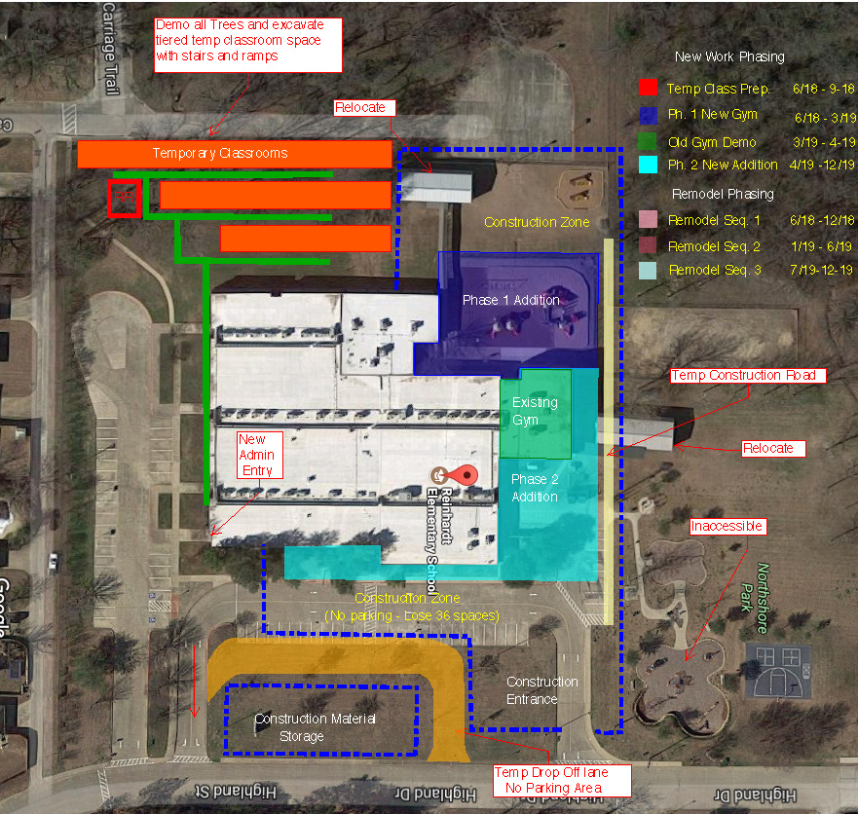
RES Renovation While Occupied

